Slide 1

Real Estate

Slide 2


What is Real Estate Business?
The real estate business is the process of selling, buying and renting the land, buildings, apartments and homes in legal manner called real estate.
In this process all legal documentations are required during the buying or selling the properties.
kavtechtraininganddevelopment@gmail.com

Slide 3
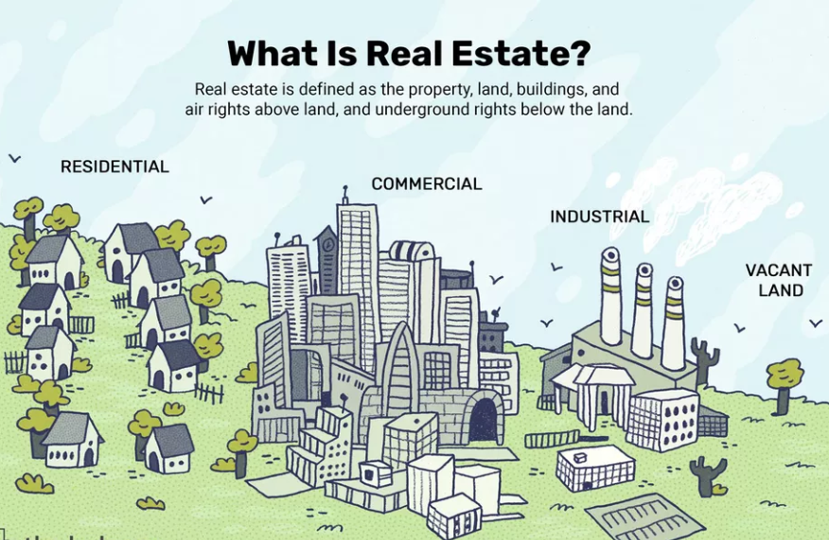
What is Real Estate?
Real estate is the property, land, buildings, air rights above the land and underground rights below the land.
Types:
Residential Real Estate- Includes both new construction and resale homes. The most common category is single-family homes. There are also condominiums, co-ops, townhouses, duplexes, triple-deckers and vacation homes.
Commercial Real Estate- Includes shopping centers and strip malls, medical and educational buildings, hotels and offices.
Industrial Real Estate- Includes manufacturing buildings and property, as well as warehouses. The buildings can be used for research, production and storage
Land- Includes vacant land, working farms, and ranches. The subcategories within vacant land include undeveloped, early development and site assembly.
kavtechtraininganddevelopment@gmail.com

Slide 4
Real Estate - Residential
Residential real estate may contain either a single family or multifamily structure that is available for occupation or for non-business purposes
Categories
Attached / multi-unit dwellings
Apartment – An individual unit in a multi-unit building. Often seen in multi-story apartment buildings.
Multi-family house – Often seen in multi-story detached buildings, where each floor is a separate apartment or unit.
Terraced house (Townhouse) – A number of single or multi-unit buildings in a continuous row with shared walls and no intervening space.
Condominium – A building or complex, similar to apartments, owned by individuals. Common grounds and common areas within the complex are owned and shared jointly.
Semi-detached dwellings
Duplex – Two units with one shared wall.
Detached dwellings
Detached house or single-family detached house
Portable dwellings
Mobile homes or residential caravans – A full-time residence that can be (although might not in practice be) movable on wheels.
Houseboats – A floating home
Tents – Usually temporary, with roof and walls consisting only of fabric-like material.
kavtechtraininganddevelopment@gmail.com

Slide 5
Ylopo
Ylopo is actually the last 5 letters of the word Monopoly spelled backwards symbolizing how we’re turning the ultimate game of real estate on its head!
Ylopo consists of a team with over 50+ years of combined experience in real estate technology, programming, digital marketing, and customer support. At Ylopo, you can trust that you are working with deep industry experts and unparalleled technology development, performance marketing, and client success teams.
Website Link: https://www.ylopo.com/about-us
kavtechtraininganddevelopment@gmail.com

Slide 6
Real Estate Terms
Sold Listing
Rental listings
Lease listings
Under contract listing
Off market listing
MLS Board
HOA(Home Owner Association) Fee
Open house
Virtual tour
Agents
Offices
Days on Market
Source Providers
Address standardization
Subdivision
Address Components
Key Listing Columns
kavtechtraininganddevelopment@gmail.com

Slide 7
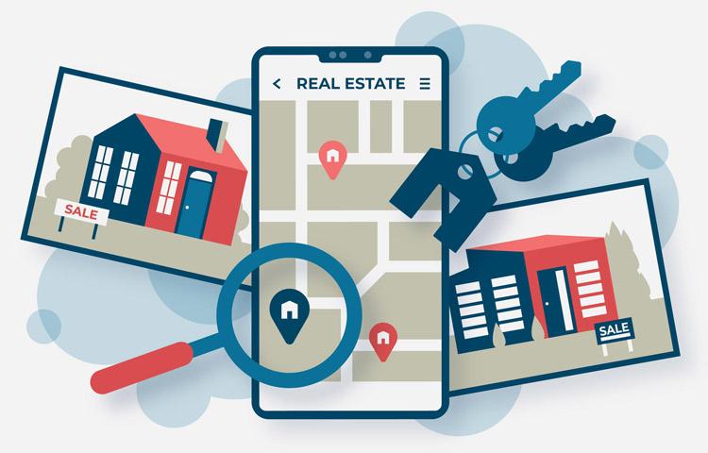
What is Listing?
Listing: Simply means a property is advertised.
“Real estate listings” include listing a home for sale by a property owner or by a licensed real estate agent.
There are various types of real estate listings:
Sold Listing: Listing that have been sold and unavailable for potential buyer.
Rental listings: It refers to homes that are purchased by an investor and inhabited by tenants on a rental agreement.
kavtechtraininganddevelopment@gmail.com

Slide 8
Listing Types
Lease listings: All real property that the Company or any of its Subsidiaries leases, subleases or otherwise uses or occupies, or has the right to use or occupy, pursuant to a Lease.
Under contract listing: A property is listed as “under contract” once a buyer has made an offer and the seller has accepted. While that’s a big step, it doesn’t mean the deal is done quite yet. So if you see a house you love that’s “under contract,” don’t give up quite yet
Off market listing: Refers to a house that has sold without ever being publicly marketed on the Multiple Listing Service (MLS) — a local database of homes for sale.
kavtechtraininganddevelopment@gmail.com

Slide 9
What is MLS?
MLS: (Multiple Listing Services) is a locality-specific database of properties for sale. Multiple listings uses a locally standardized format to provide brokers with comprehensive, detailed information about the location, size, age, and features of properties.
kavtechtraininganddevelopment@gmail.com

Slide 10
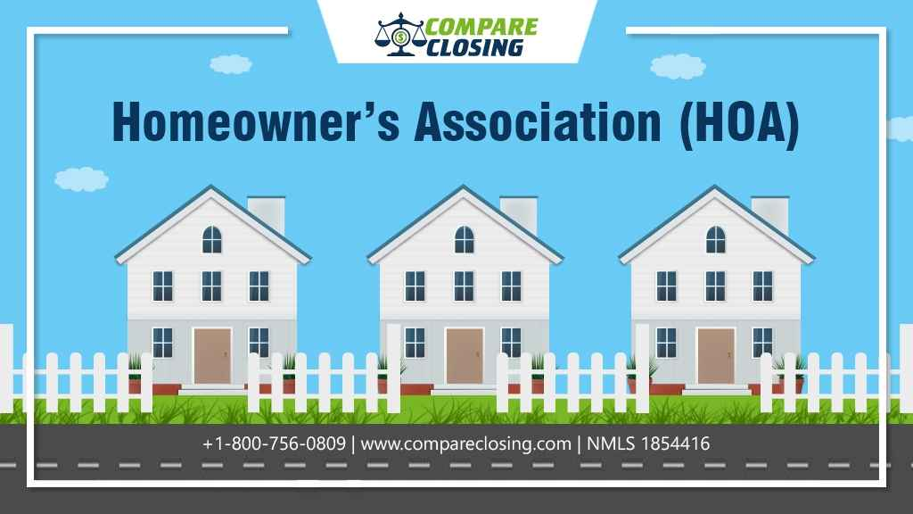
(HOA) Fee
Homeowners Association (HOA) Fee:
HOA fee is a recurring fee paid by some homeowners to an organization that helps maintain and improve their property and others in the same group.
kavtechtraininganddevelopment@gmail.com

Slide 11

Open House
A scheduled period in which a house or other dwelling is designated to be open for viewing for potential buyers.
kavtechtraininganddevelopment@gmail.com

Slide 12
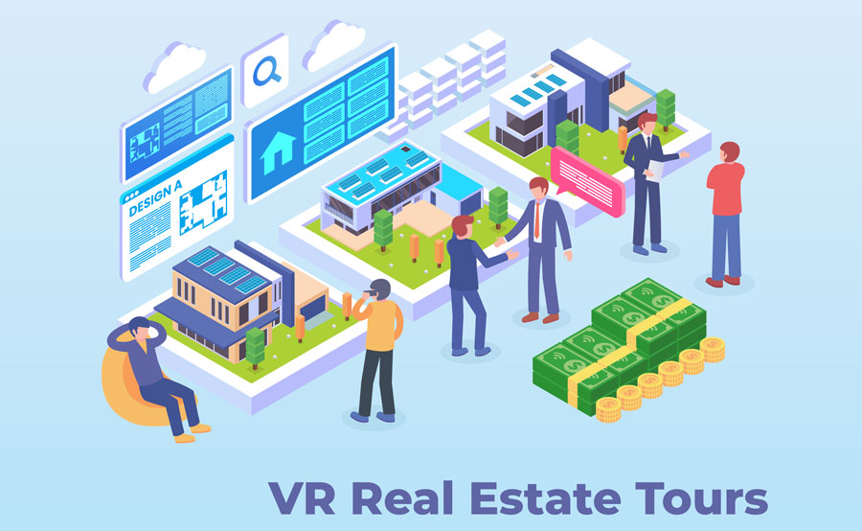
Virtual Tour
To indicate whether you have included a virtual tour of your subject property.
kavtechtraininganddevelopment@gmail.com

Slide 13
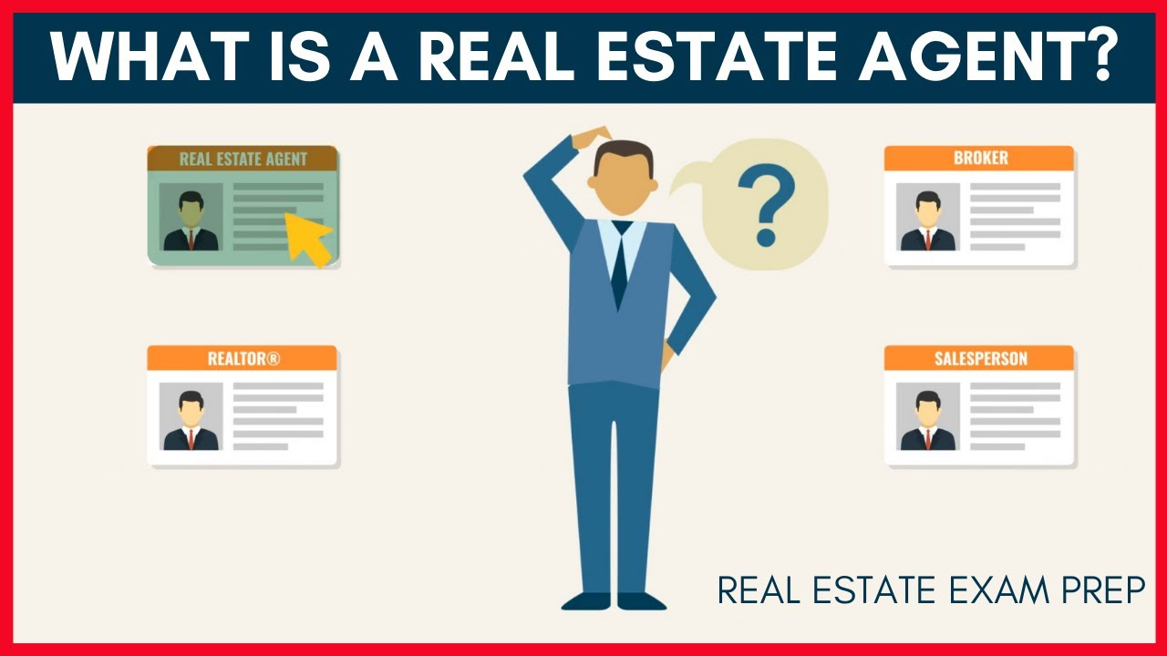
kavtechtraininganddevelopment@gmail.com

Slide 14
What is an Agent?
A person authorized to act on another’s behalf.
In real estate, this agent may be:
A listing agent representing the seller
A selling agent representing the buyer
A dual agent which means the agent or company may represent both the seller and the buyer.
A transaction agent (or broker) that represents neither party but helps the transaction to be completed.
A real estate agent must be licensed under the laws of their state.
An agent must place their license under the direction of a real estate broker.
To become a broker, one must take the same courses that a salesperson does, but also complete addition training and meet experience requirements which differ from state to state.
kavtechtraininganddevelopment@gmail.com

Slide 15

Offices
A Property improved with a building or buildings the substantial use of which is office space, which may include a Property that is part of a Mixed-Use Project.
kavtechtraininganddevelopment@gmail.com

Slide 16
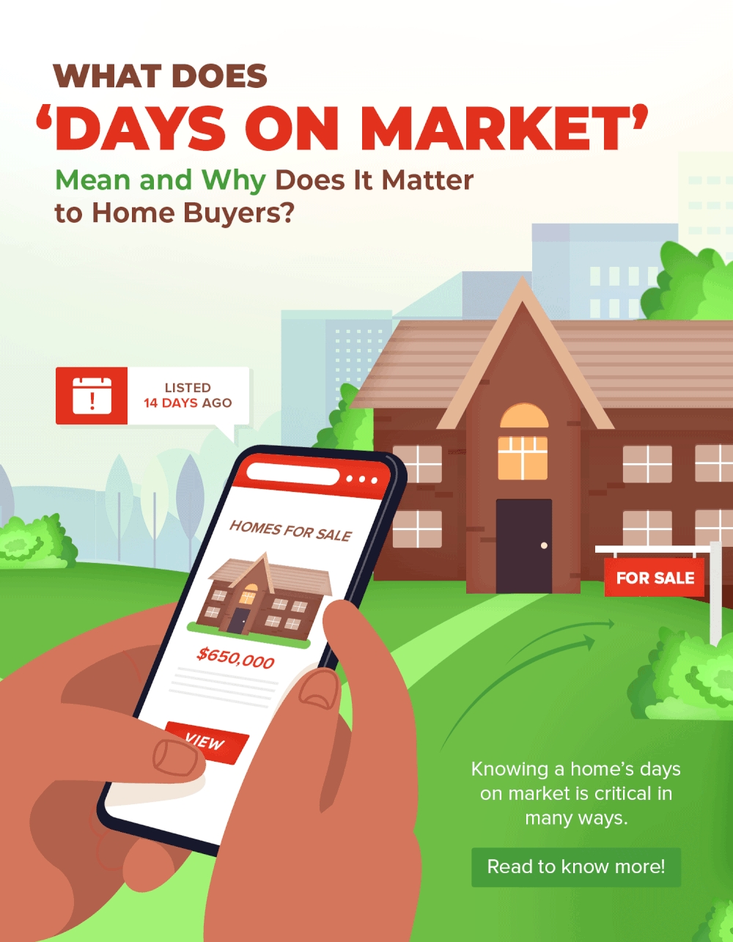
Days on market (DOM)
DOM is defined as the number of days from the date on which the property is listed for sale on the local real estate brokers’ multiple listing service (MLS) to the date when the seller has signed a contract for the sale of the property with the buyer.
kavtechtraininganddevelopment@gmail.com

Slide 17
Real Estate Data Providers
IDX data feeds
RETS data feeds
Trestle data feeds
MLS Grid data feeds
API based data feed
kavtechtraininganddevelopment@gmail.com

Slide 18
Address Standardization
Listing Address →full_street_address
Mapping:
Concat all source columnsFormula:
Street number + Street dir prefix + Street name + Street prefix + Street suffix + Street Dir Suffix
If we are not receiving a particular column from source we do not map it and concat it but mentioned fields are preferred.
kavtechtraininganddevelopment@gmail.com

Slide 19
Subdivision
To add subdivision name to the system.
kavtechtraininganddevelopment@gmail.com

Slide 20
Address Components
The field is a combination of all address fields which include Street Number, Street Name, Unit Number, City, State, and Zip code.
kavtechtraininganddevelopment@gmail.com

Slide 21
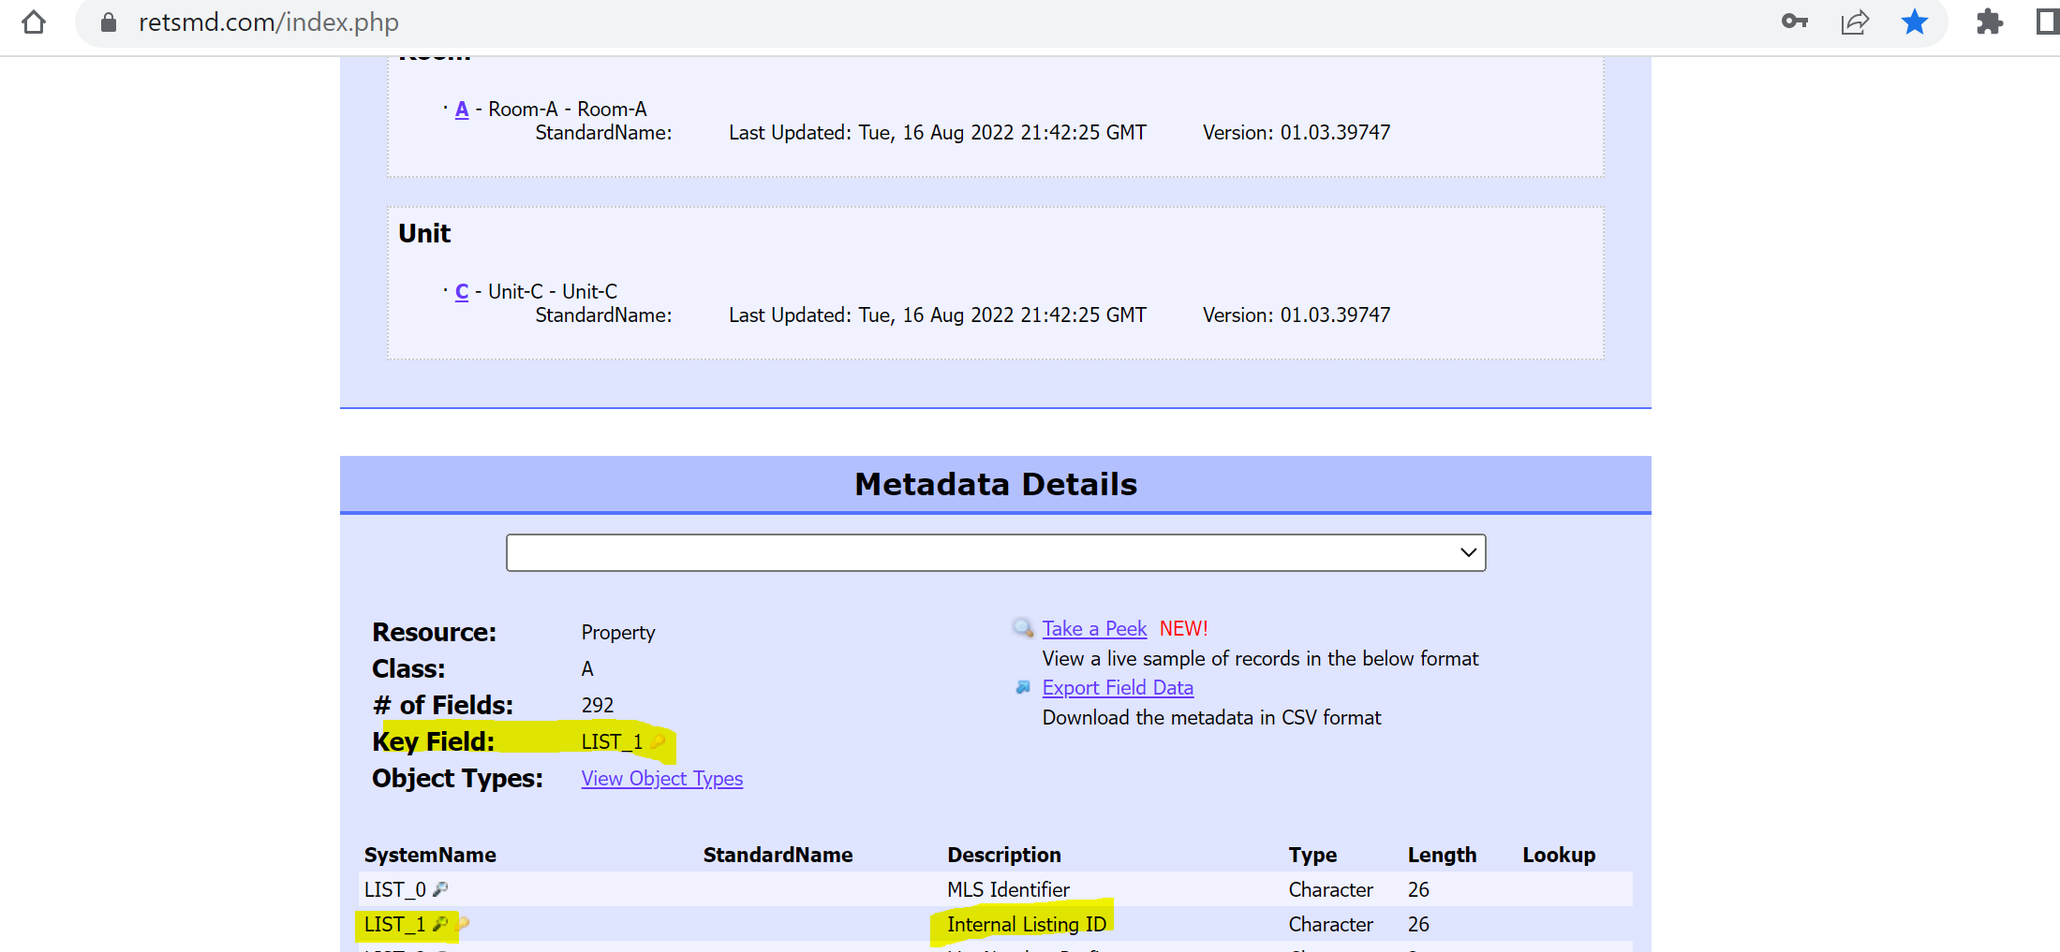
Key Listing Columns
kavtechtraininganddevelopment@gmail.com

Slide 22
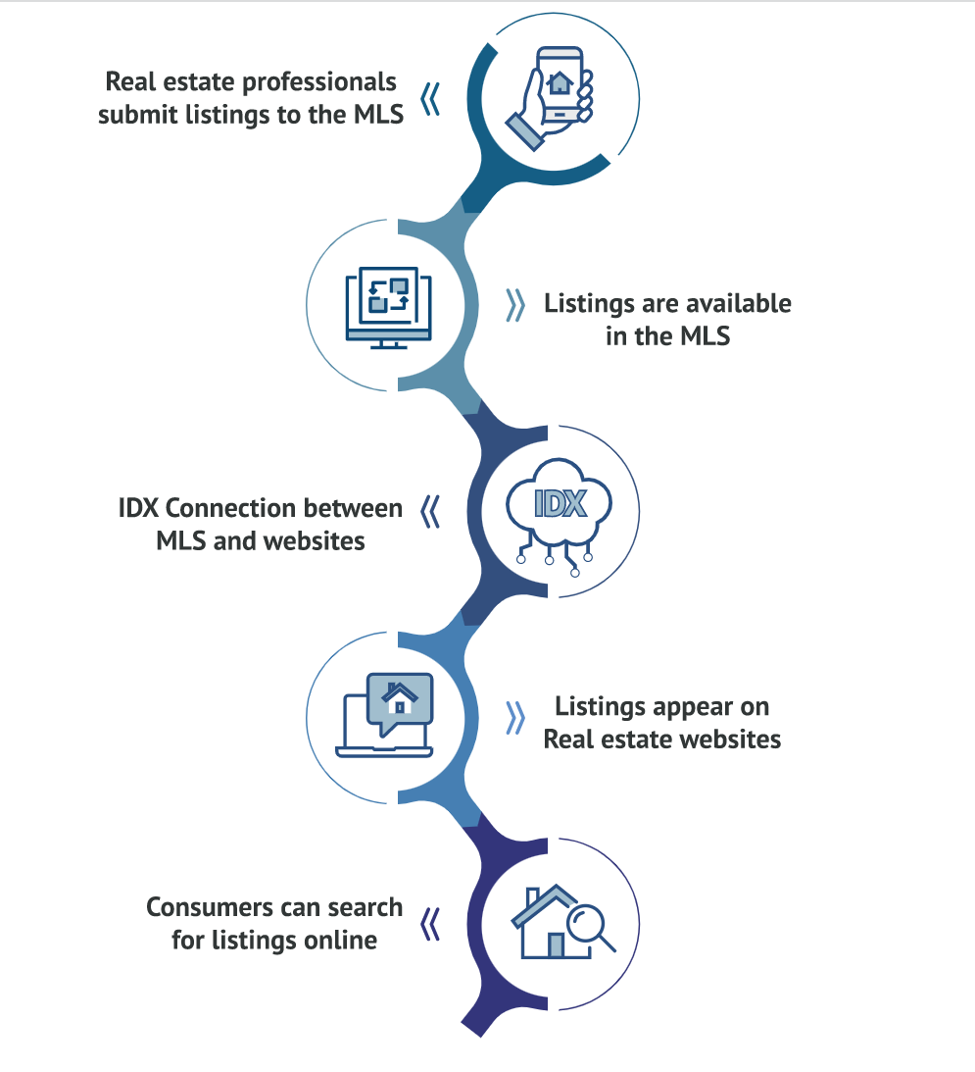
What is an IDX?
A real estate Internet Data Exchange (IDX) is a data software that connects an agent’s website to their local Multiple Listing Service (MLS) database.
The IDX allows agents to display MLS listings on their own websites so that visitors can search for available properties within a selected area.
These additional properties to view beyond your own exclusive listings will increase lead capture and traffic to your website.
kavtechtraininganddevelopment@gmail.com

Slide 23
IDX Data Feed
Internet Data Exchange (IDX) is an umbrella term used to cover policies, standards, and software pertaining to the display of real estate listing information on websites.
Most importantly for agents and brokers, IDX is what enables members of a multiple listing service (MLS) to integrate real estate listings from the MLS database into their own websites.
An IDX feed is a data connection that transfers listings data between a real estate agent’s website and a Multiple Listing Service (MLS) and updates those listings as properties come on or off the market.
kavtechtraininganddevelopment@gmail.com

Slide 24
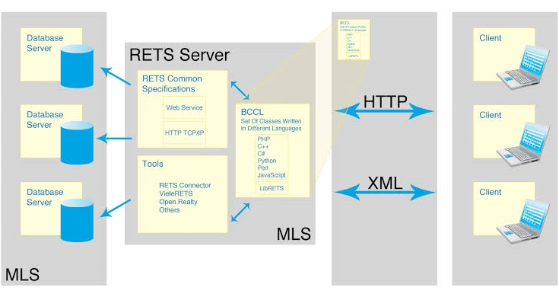
What is RETS?
RETS is an acronym which stands for Real Estate Transaction Standard.
RETS is a framework used in the United States and Canada by the real estate industry to facilitate the exchange of data
There are more than 700 small and medium MLS each managing its own database.
Each of these MLS might choose different policies and procedures. The lack of coordination would make it very difficult for agents and brokers to display listings online and conduct business.
RETS was introduced in 1999 to avoid this.
kavtechtraininganddevelopment@gmail.com

Slide 25
RETS Data Feed
A RETS data feed is a unique raw data connection between your system and your MLS based on the Real Estate Transaction Standard that allows you to import property listings, and with the right software, display them on your website.
Many agents use a RETS data feed to set up a property search on their website. As an alternative to IDX, a RETS data feed provides greater flexibility, better SEO, and often faster updates.
With a RETS data feed you are able to select the property and listing types you want to import to your site, allowing you to construct a property search that matches your business model.
kavtechtraininganddevelopment@gmail.com

